Slide 1
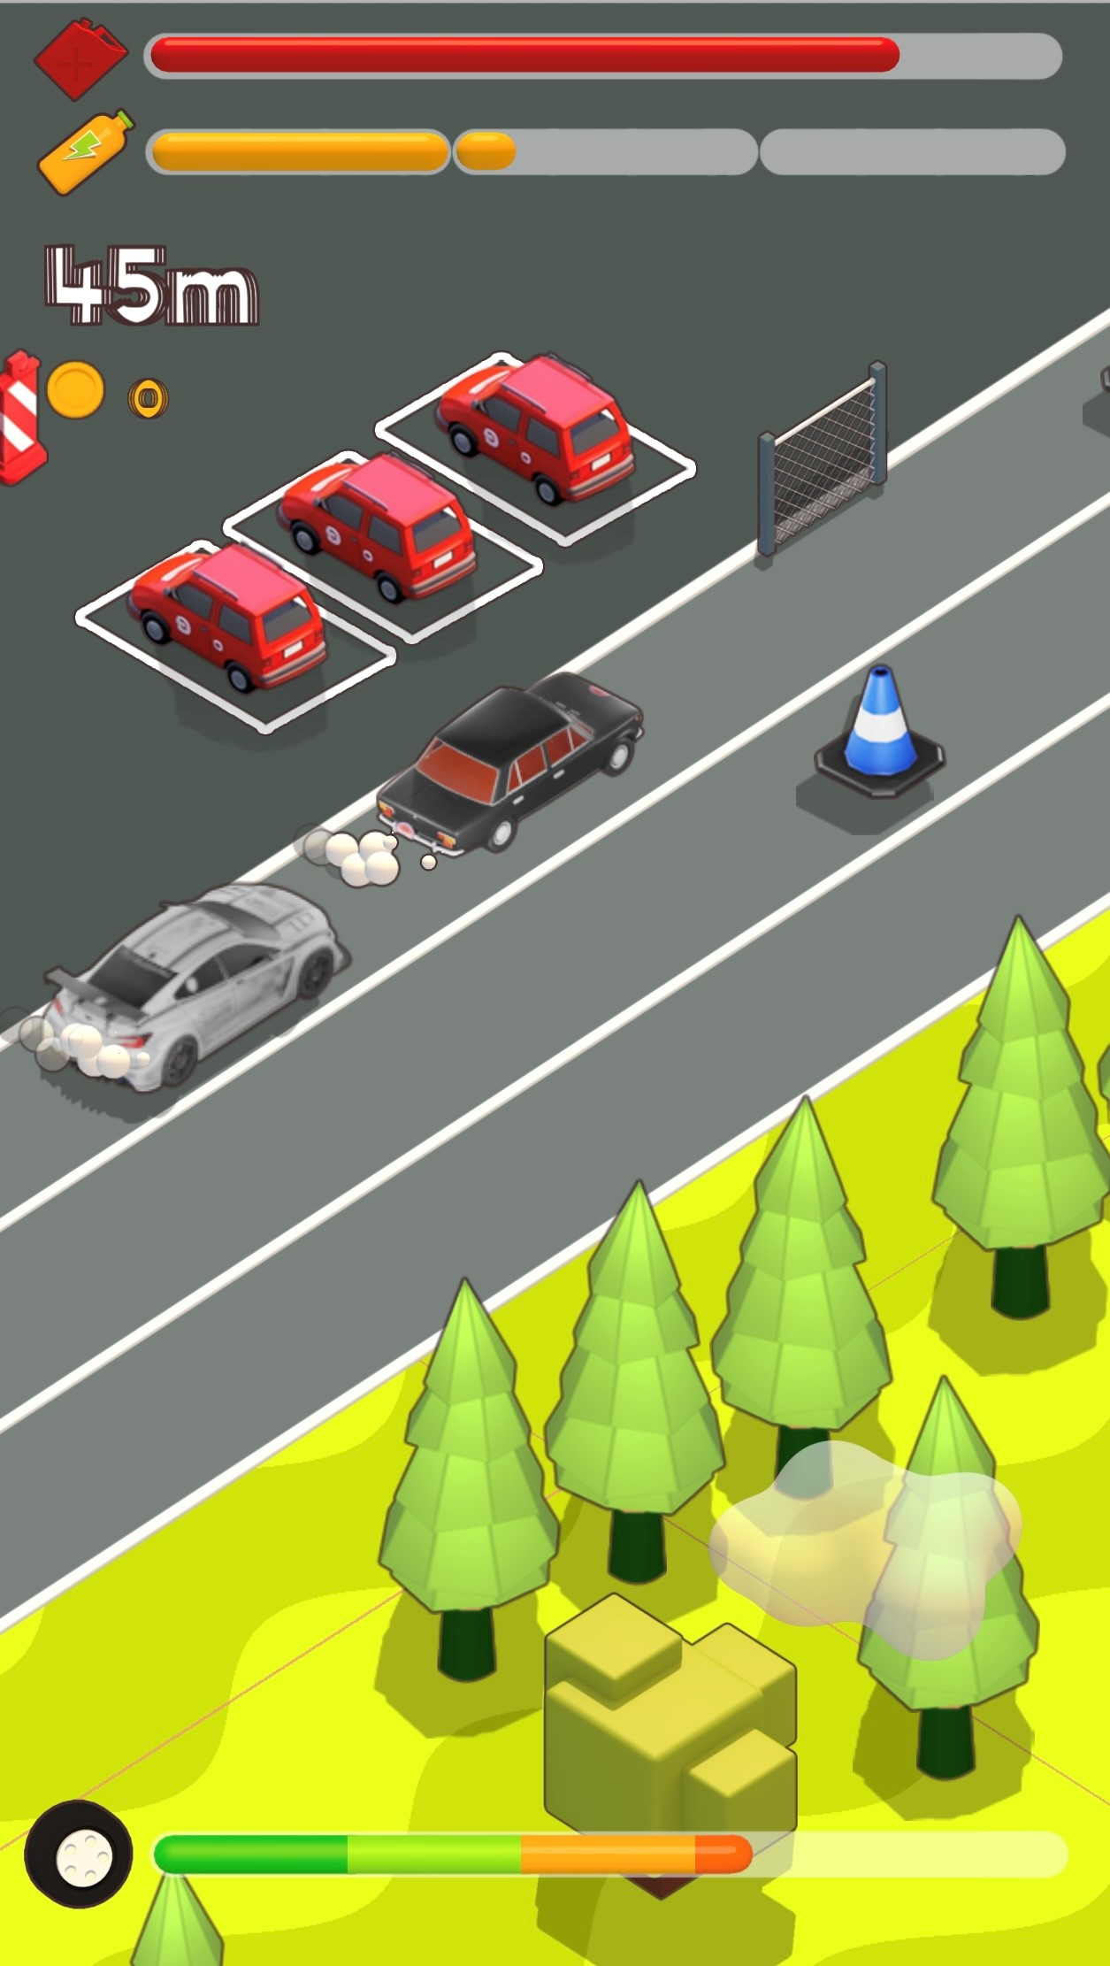
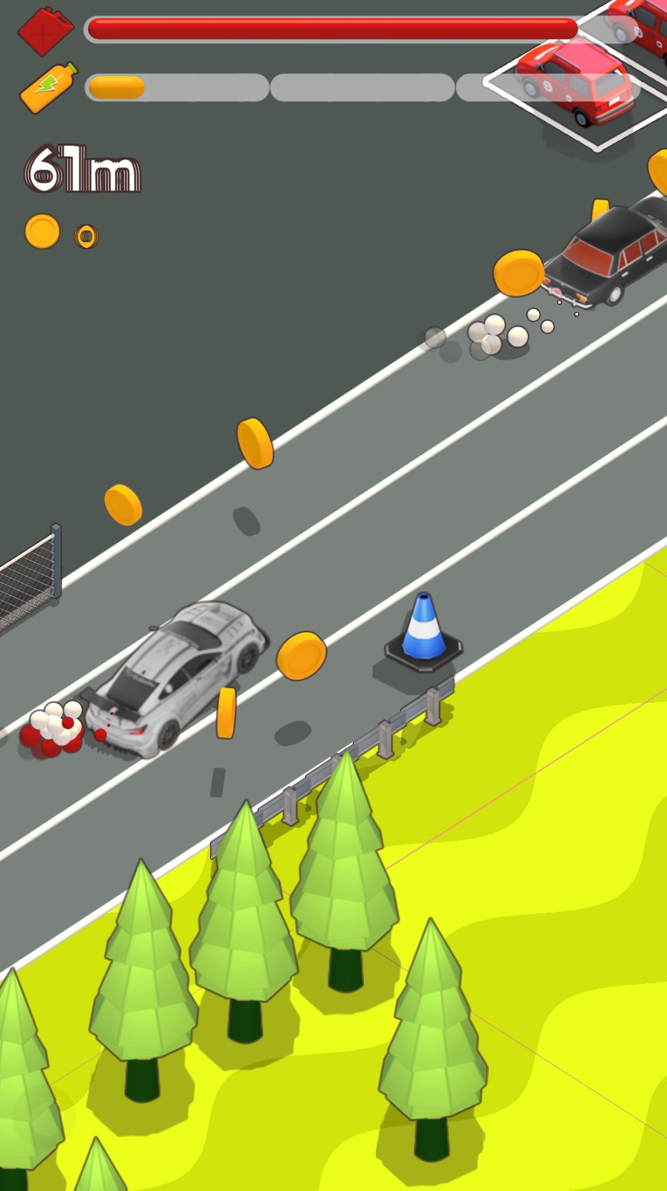
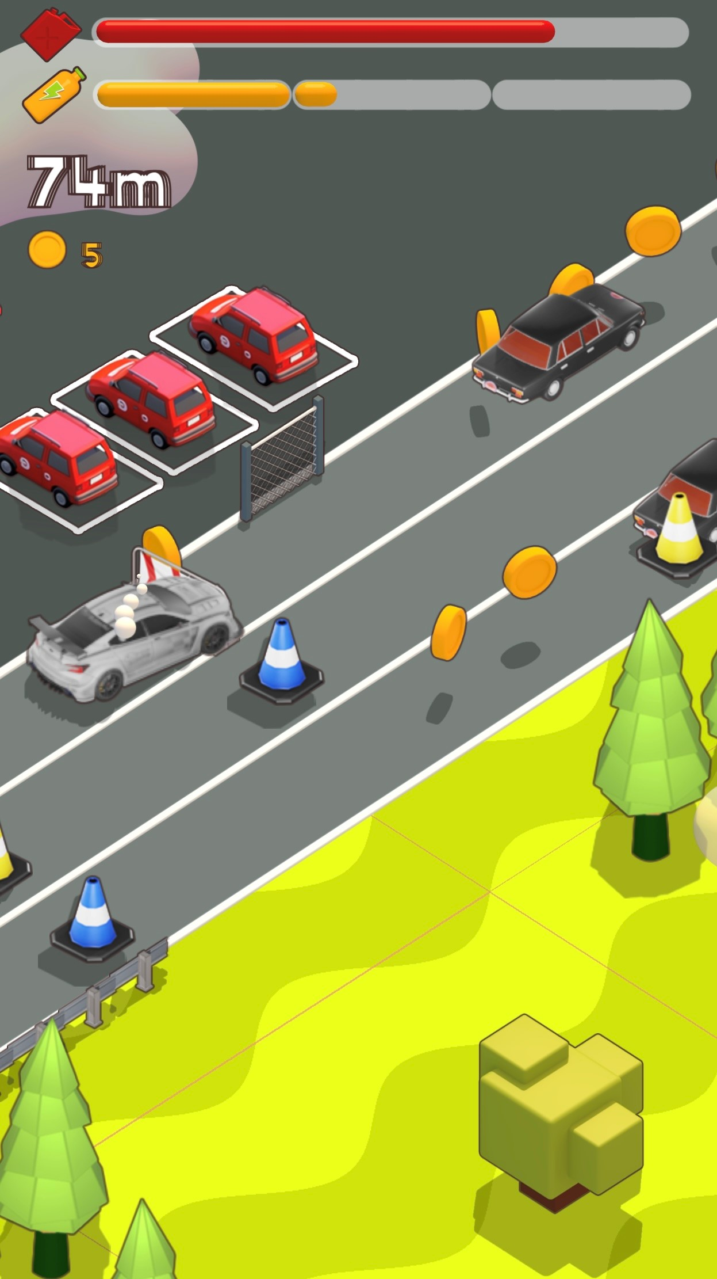
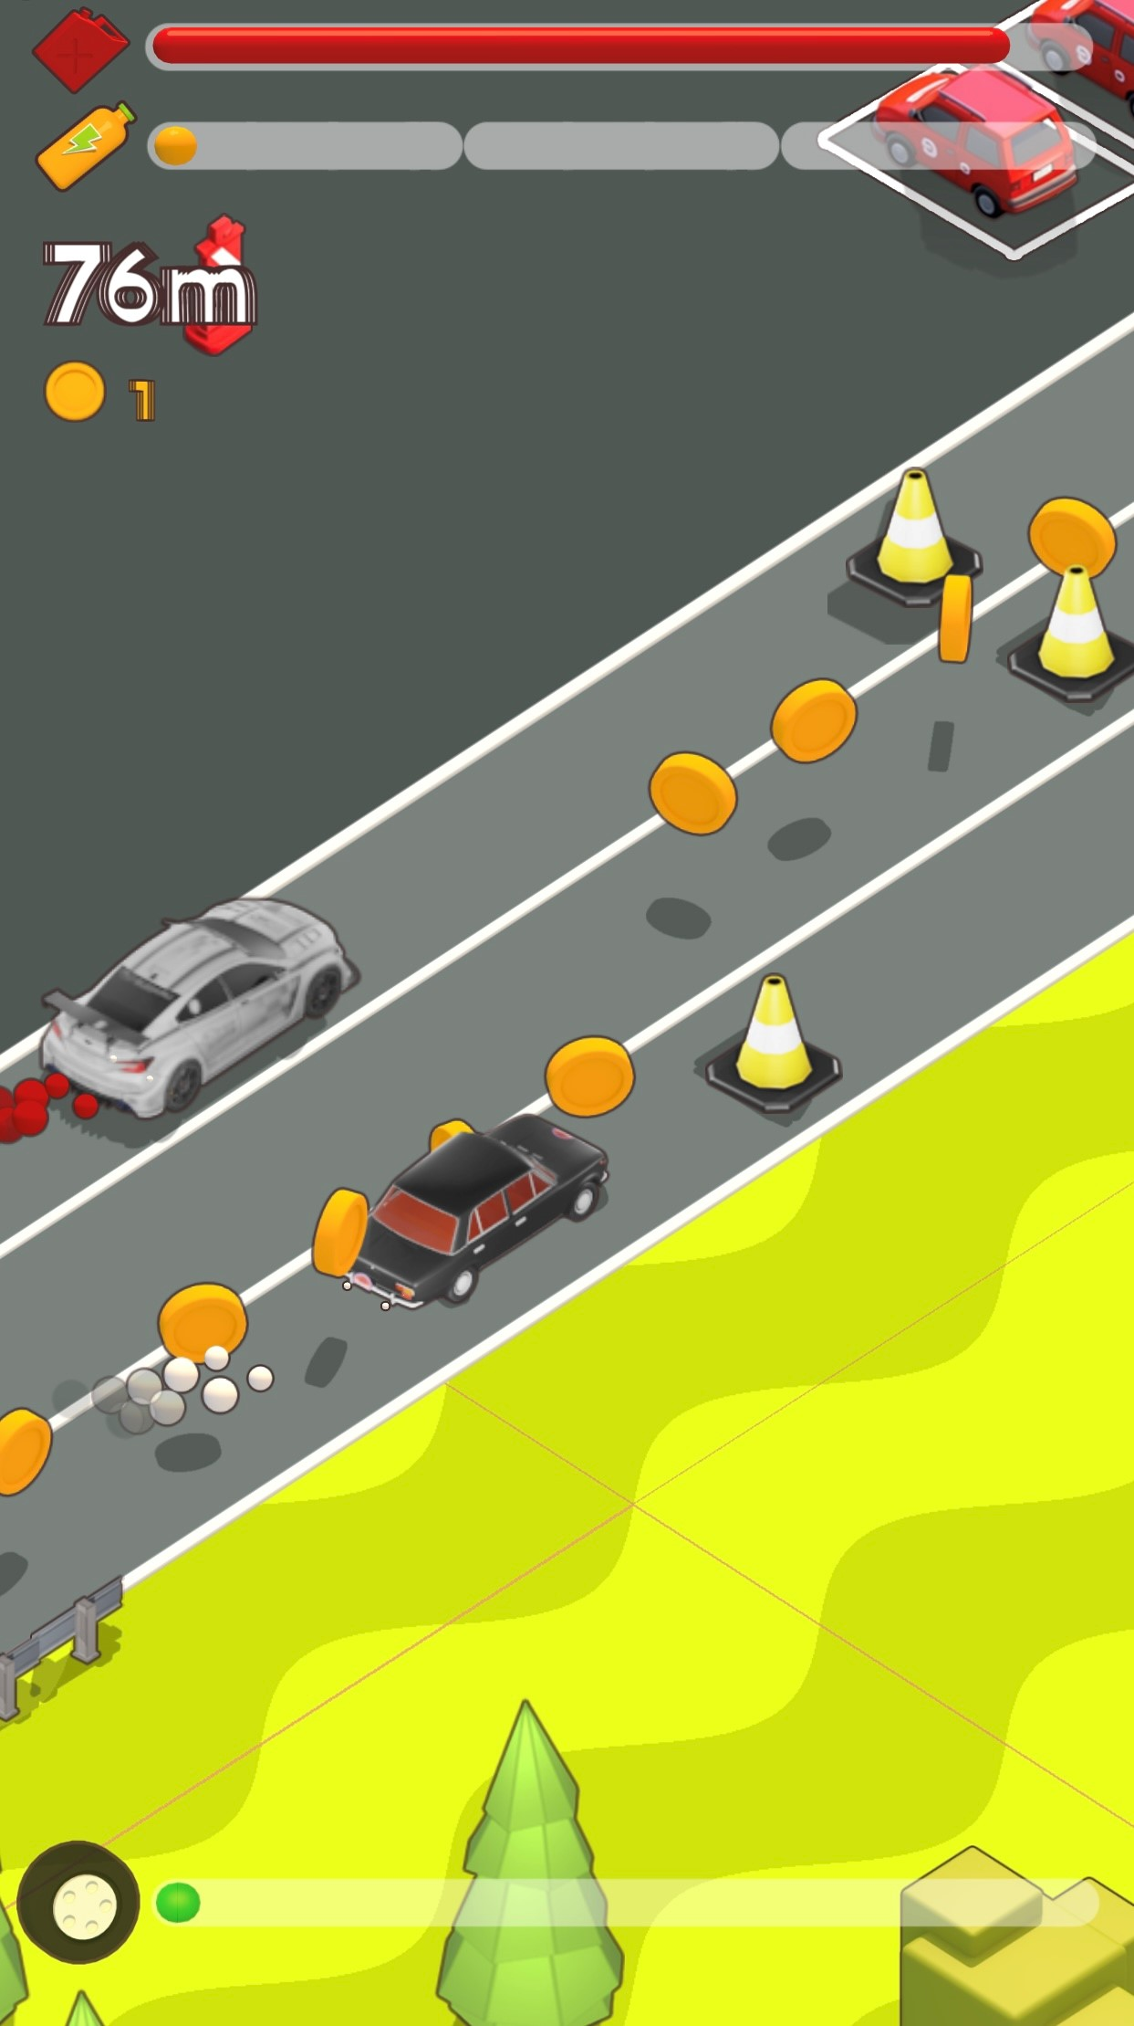
Select your car and enter the Tour car World. Avoid objects on the track and see how far you can get. Classic Arcade driving action with smooth graphics makes Tour Cars a must play game.

